Slide 1
Basic concepts in sampling and Quantization , Representing digital images & Neighbors of a pixel, Adjacency, Connectivity, Regions and Boundaries

Slide 2
Basic concepts in sampling and Quantization

Slide 3
Image sampling and quantization
In order to process the image, it must be saved on computer.
The image output of most sensors (eg: Camera) is continuous voltage waveform.
But computer deals with digital images not with continuous images, thus: continuous images should be converted into digital form.
continuous image (in real life) → digital (computer)

Slide 4
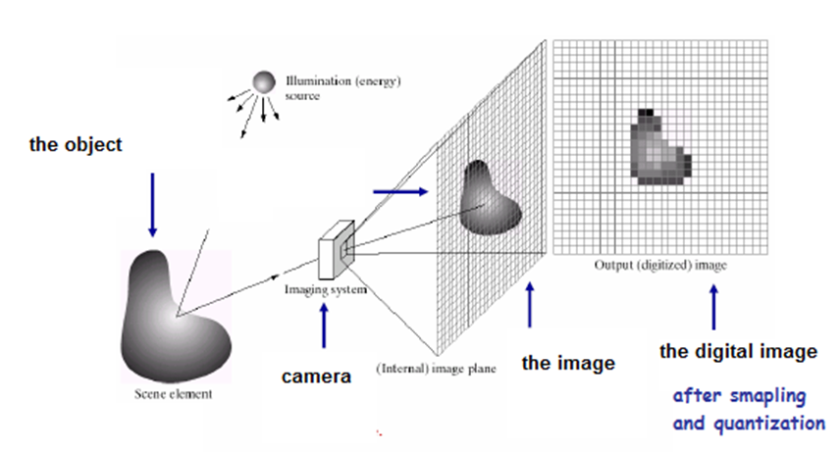
Image sampling and quantization

Slide 5
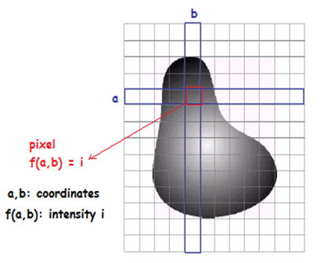
Image sampling and quantization
Continuous image (in real life) → digital (computer)
To do this we use Two processes: Sampling and quantization.
Remember that the image is a function f(x,y),
x and y are coordinates
f -> intensity value (Amplitude)
Sampling: digitizing the coordinate values
Quantization: digitizing the amplitude values
Thus, when x, y and f are all finite, discrete quantities,
we call the image a digital image.

Slide 6
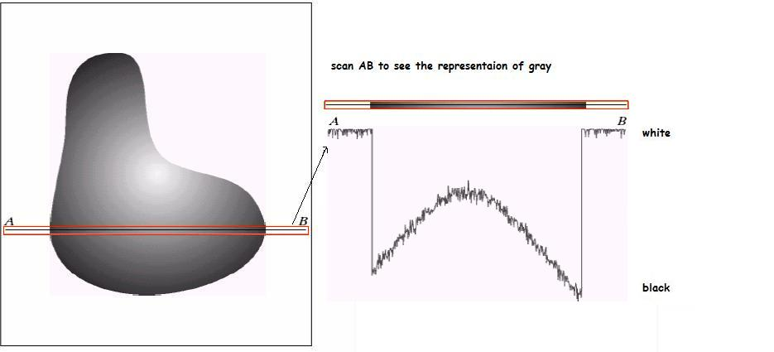
How does the computer digitize the continuous image? Ex: scan a line such as AB from the continuous image, and represent the gray intensities.

Slide 7
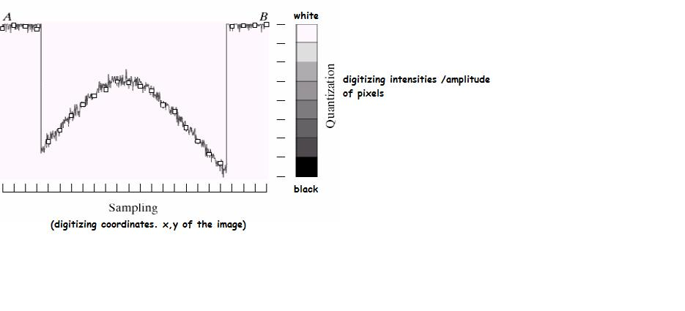
How does the computer digitize the continuous image? Sampling: digitizing coordinates Quantization: digitizing intensities
Gray-level scale that divides gray-level into 8 discrete levels
Quantization: converting each sample gray-level value into discrete digital quantity.
sample is a small white square, located by a vertical tick mark as a point x,y

Slide 8
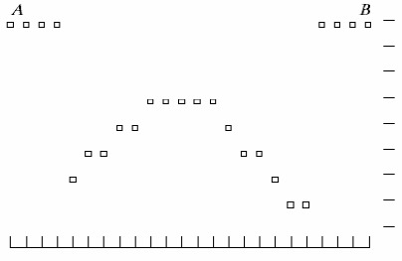

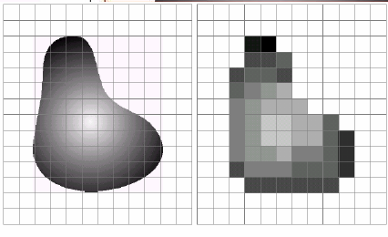
How does the computer digitize the continuous image?
Now:
the digital scanned line AB representation on computer:
The continuous image VS the result of digital image after sampling and quantization

Slide 9
Representing Digital Images

Slide 10
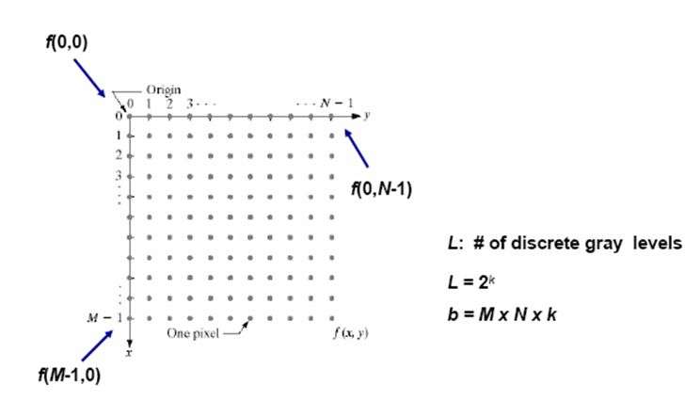
Representing Digital Images
Every pixel has a # of bits.

Slide 11
Digital Image Representation Coordinate Conventions
The result of sampling and quantization is a matrix of real numbers
There are two principle ways to represent a digital image:
Assume that an image f(x,y) is sampled so that the resulting image has M rows and N columns.
We say that the image is of size M x N. The values of the coordinates (x,y) are discrete quantities.
For clarity, we use integer values for these discrete coordinates.
In many image, the origin is defined to be at (x,y) = (0,0).
The next coordinate values along the first row of the image are (x,y) = (0,1).
It is important to keep in mind that the notation (0,1) is used to signify the second sample along the first row.
It does not mean that these are the actual values of physical coordinates. Note that x ranges from 0 to M-1, and y ranges from 0 to N-1.

Slide 12
Digital Image Representation Coordinate Conventions
The coordinate convention used in toolbox to denote arrays is different from the preceding paragraph in two minor ways.
Instead of using (x,y) the toolbox uses the notation (r,c) to indicate rows and columns.
The origin of the coordinate system is at (r,c) = (1,1); thus, r ranges from 1 to M and c from 1 to N, in integer increments. This coordinate convention is shown in Figure (b).

Slide 13
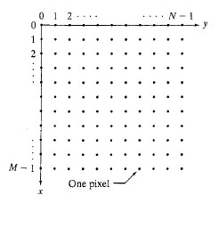
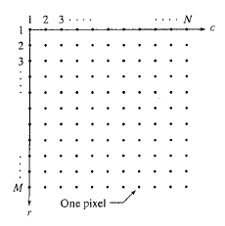
Digital Image Representation Coordinate Conventions
(A)
(B)

Slide 14

Digital Image Representation Images as Matrices
The coordination system in figure (A) and the preceding discussion lead to the following representation for a digitized image function:

Slide 15

Digital Image Representation Images as Matrices
The right side of the equation is a digital image by definition. Each element of this array is called an image element, picture element, pixel or pel.
A digital image can be represented naturally as a MATLAB matrix:
Where f(1,1) = f(0,0). Clearly, the two representations are identical, except for the shift in origin.

Slide 16
Pixels!
Every pixel has # of bits (k)
Q: Suppose a pixel has 1 bit, how many gray levels can it represent?
Answer: 2 intensity levels only, black and white.
Bit (0,1) → 0:black , 1: white
Q: Suppose a pixel has 2 bit, how many gray levels can it represent?
Answer: 4 gray intensity levels
2Bit (00, 01, 10 ,11).
Q: if we want to represent 256 intensities of grayscale, how many bits do we need?
Answer: 8 bits → which represents: 2⁸=256
so, the gray intensities ( L ) that the pixel can hold, is calculated according to according to number of pixels it has (k). L= 2^{k}

Slide 17
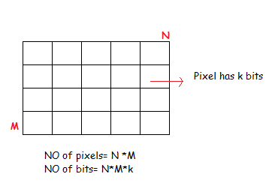
Number of storage of bits:
N * M: the no. of pixels in all the image.
K: no. of bits in each pixel
L: grayscale levels the pixel can represent
L= 2^{K}
all bits in image= N*N*k

Slide 18
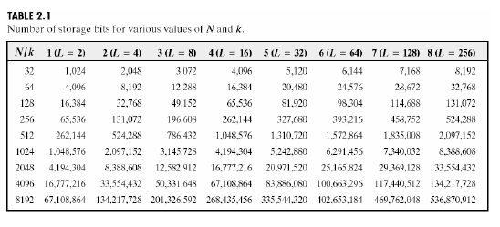
Number of storage of bits:
EX: Here: N=32, K=3, L = 2³ =8
# of pixels=N*N = 1024 . (because in this example: M=N)
# of bits = N*N*K = 1024*3= 3072
N=M in this table, which means no. of horizontal pixels= no. of vertical pixels. And thus:
# of pixels in the image= N*N

Slide 19
Image Size (in Bits)
Image Size = Height x Width X Bits/pixel
Example:
Consider image 320x240 pixels with 8 bits per pixel
Image takes storage 7680 x 8 bits = 61440 bits or 7680 bytes

Slide 20

Spatial and gray-level resolution
Sampling is the principal factor determining the spatial resolution of an image
Basically, spatial resolution is the smallest discernible detail in an image.
Gray-level resolution refers to the smallest discernible change in gray level

Slide 21
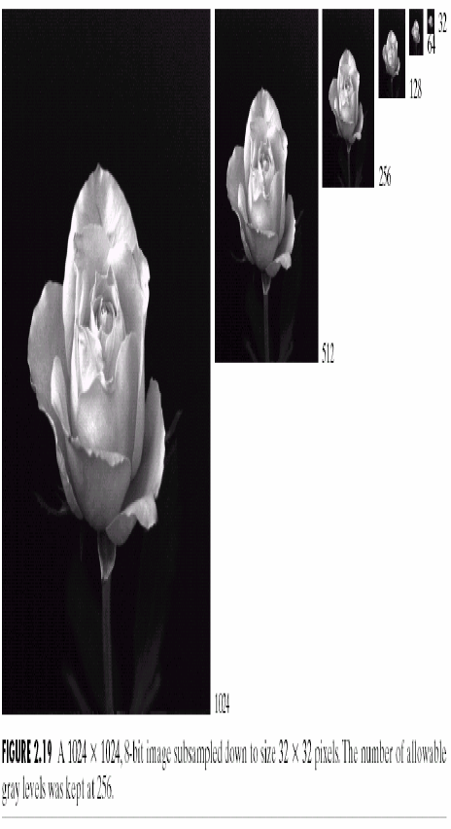
Spatial and gray-level resolution
Sub sampling
Same # of bits in all images (same gray level)
different # of pixels
subSampling is performed by deleting rows and columns from the original image.

Slide 22
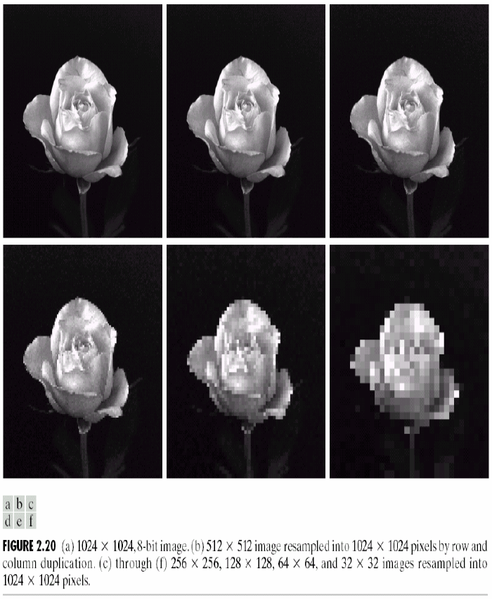
Spatial and gray-level resolution
Re sampling
(pixel replication)
A special case of nearest neighbor zooming.
Resampling is performed by row and column duplication

Slide 23
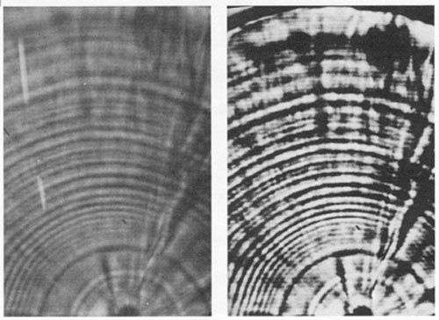
Image Representations
Black and white image
single color plane with 2 bits
Grey scale image
single color plane with 8 bits
Color image
three color planes each with 8 bits
RGB, CMY, YIQ, etc.
Indexed color image
single plane that indexes a color table
Compressed images
TIFF, JPEG, BMP, etc.
4 gray levels
2gray levels

Slide 24
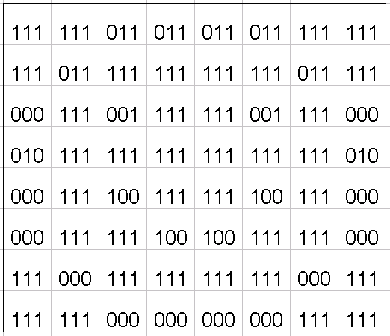
Digital Image Representation (3 Bit Quantization)

Slide 25

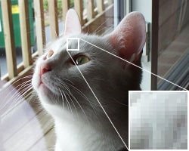
Color Quantization Example of 24 bit RGB Image
24-bit Color Monitor

Slide 26
Image Representation Example
24 bit RGB Representation (uncompressed)
128 | 135 | 166 | 138 | 190 | 132
129 | 255 | 105 | 189 | 167 | 190
229 | 213 | 134 | 111 | 138 | 187
128 | 138
129 | 189
229 | 111
135 | 190
255 | 167
213 | 138
166 | 132
105 | 190
134 | 187
Color Planes

Slide 27
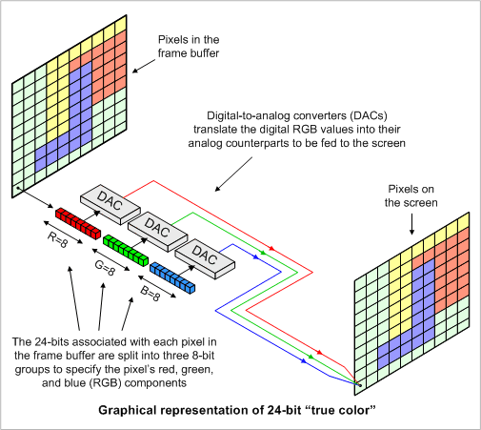
Graphical Representation

Slide 28

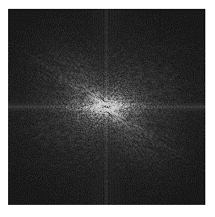
Spatial and Frequency Domains
Spatial domain
refers to planar region of intensity values at time t
Frequency domain
think of each color plane as a sinusoidal function of changing intensity values
refers to organizing pixels according to their changing intensity (frequency)

Slide 29
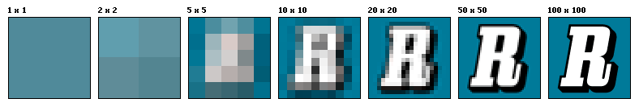

Spatial Resolution and Brightness
Spatial Resolution (depends on: )
Image size
Viewing distance
Brightness
Perception of brightness is higher than perception of color
Different perception of primary colors
Relative brightness: green:red:blue=
59%:30%:11%
Source: wikipedia

Slide 30
How to choose the spatial resolution
Spatial resolution
= Sampling locations
Original image
Sampled image
Under sampling, we lost some image details!

Slide 31
How to choose the
spatial resolution : Nyquist Rate
Sampled image
Original image
2mm
1mm
No detail is lost!
Minimum
Period
Nyquist Rate:
Spatial resolution must be less or equal
half of the minimum period of the image
or sampling frequency must be greater or
Equal twice of the maximum frequency.
Spatial resolution
(sampling rate)
= Sampling locations

Slide 32
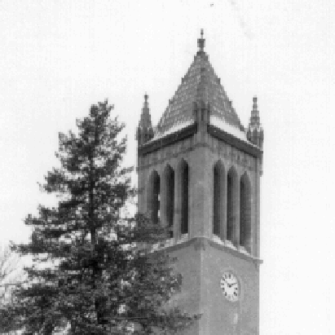
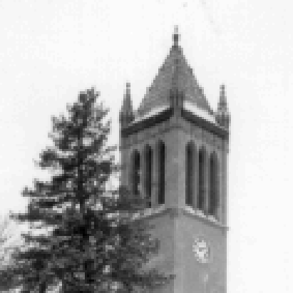

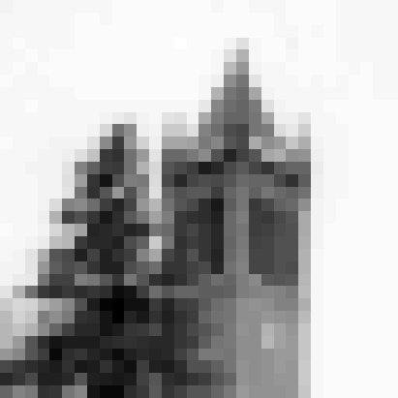
Effect of Spatial Resolution
256x256 pixels
128x128 pixels
64x64 pixels
32x32 pixels

Slide 33
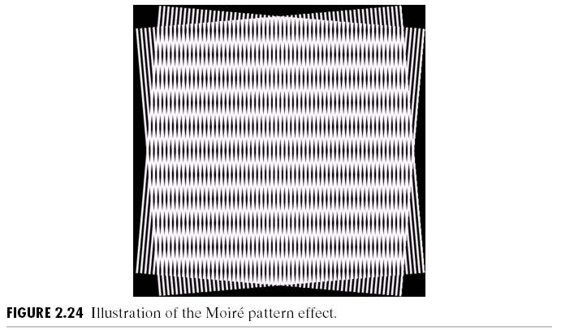
Moire Pattern Effect : Special Case of Sampling
Moire patterns occur when frequencies of two superimposed
periodic patterns are close to each other.

Slide 34
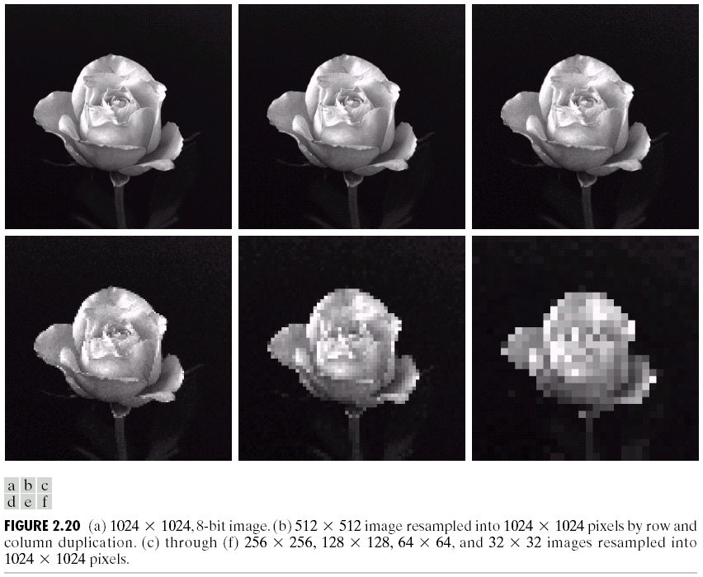
Effect of Spatial Resolution

Slide 35
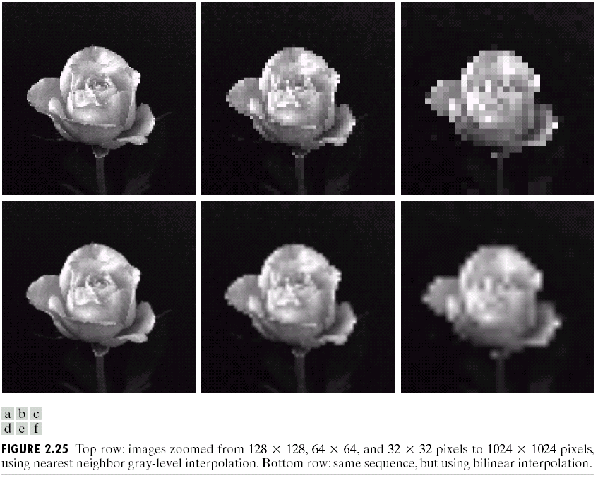
Can we increase spatial resolution by interpolation ?
Down sampling is an irreversible process.

Slide 36
Image Quantization
Image quantization:
discretize continuous pixel values into discrete numbers
Color resolution/ color depth/ levels:
- No. of colors or gray levels or
- No. of bits representing each pixel value
- No. of colors or gray levels N_{c} is given by
where b = no. of bits

Slide 37
Quantization function
N_{c}-1
N_{c}-2
Quantization level
2
1
0
Light intensity
Darkest
Brightest

Slide 38



Effect of Quantization Levels
256 levels
128 levels
64 levels
32 levels

Slide 39




Effect of Quantization Levels (cont.)
16 levels
8 levels
In this image,
it is easy to see
false contour.
4 levels
2 levels

Slide 40
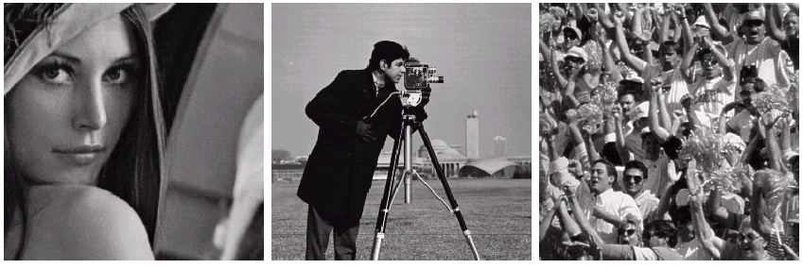
How to select the suitable size and pixel depth of images
The word “suitable” is subjective: depending on “subject”.
Low detail image
Medium detail image
High detail image
Lena image
Cameraman image
To satisfy human mind
1. For images of the same size, the low detail image may need more pixel depth.
2. As an image size increase, fewer gray levels may be needed.

Slide 41
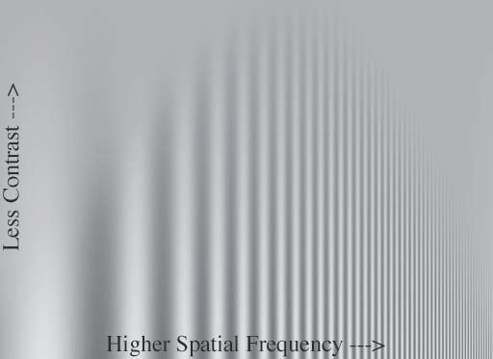
Human vision:
Spatial Frequency vs Contrast

Slide 42



Human vision: Distinguish ability
for Difference in brightness
Regions with 5% brightness difference

Slide 43
Basic Relationship of Pixels
(0,0)
x
(x-1,y-1)
(x,y-1)
(x+1,y-1)
(x-1,y)
(x,y)
(x+1,y)
y
(x-1,y+1)
(x,y+1)
(x+1,y+1)
Conventional indexing method

Slide 44
Neighbors of a Pixel

Slide 45
Neighbors of a Pixel
Neighborhood relation is used to tell adjacent pixels. It is
useful for analyzing regions.
4-neighbors of p:
(x,y-1)
(x-1,y)
(x+1,y)
(x,y-1)
(x,y+1)
(x-1,y)
p
(x+1,y)
N₄(p) =
(x,y+1)
4-neighborhood relation considers only vertical and
horizontal neighbors.
Note: q Î N₄(p) implies p Î N₄(q)

Slide 46
Neighbors of a Pixel (cont.)
8-neighbors of p:
(x-1,y-1)
(x,y-1)
(x+1,y-1)
(x-1,y-1)
(x,y-1)
(x+1,y-1)
(x-1,y)
(x+1,y)
(x-1,y+1)
(x,y+1)
(x+1,y+1)
(x-1,y)
p
(x+1,y)
(x-1,y+1)
(x,y+1)
(x+1,y+1)
N₈(p) =
8-neighborhood relation considers all neighbor pixels.

Slide 47
Neighbors of a Pixel (cont.)
Diagonal neighbors of p:
(x-1,y-1)
(x+1,y-1)
(x-1,y-1)
(x+1,y-1)
(x-1,y+1)
(x+1,y+1)
p
N_{D}(p) =
(x-1,y+1)
(x+1,y+1)
Diagonal -neighborhood relation considers only diagonal neighbor pixels.

Slide 48
Connectivity
Connectivity is adapted from neighborhood relation. Two pixels are connected if they are in the same class (i.e. the same color or the same range of intensity) and they are neighbors of one another.
For p and q from the same class
w 4-connectivity: p and q are 4-connected if q Î N₄(p)
w 8-connectivity: p and q are 8-connected if q Î N₈(p)
w mixed-connectivity (m-connectivity):
p and q are m-connected if q Î N₄(p) or q Î N_{D}(p) and N₄(p) Ç N₄(q) = Æ

Slide 49
Adjacency
A pixel p is adjacent to pixel q is they are connected. Two image subsets S₁ and S₂ are adjacent if some pixel in S₁ is adjacent to some pixel in S₂
S₁
S₂
We can define type of adjacency: 4-adjacency, 8-adjacency or m-adjacency depending on type of connectivity.

Slide 50
Path
A path from pixel p at (x,y) to pixel q at (s,t) is a sequence of distinct pixels:
(x₀,y₀), (x₁,y₁), (x₂,y₂),…, (x_{n},y_{n}) such that
(x₀,y₀) = (x,y) and (x_{n},y_{n}) = (s,t) and (x_{i},y_{i}) is adjacent to (x_{i-1},y_{i-1}), i = 1,…,n
q
p
We can define type of path: 4-path, 8-path or m-path depending on type of adjacency.

Slide 51
Path (cont.)
8-path
m-path
p
p
p
q
q
q
m-path from p to q
solves this ambiguity
8-path from p to q
results in some ambiguity

Slide 52
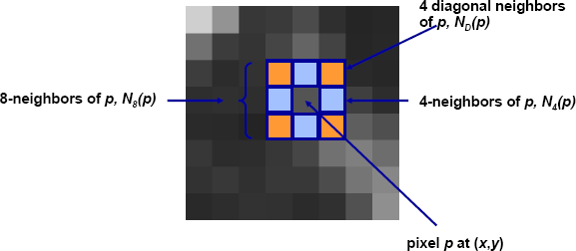
Neighbors of a pixel
some of the points in N_{D} (p) and N₈ (p) fall outside the image if (x,y) is on the border of the image.
2

Slide 53
Connectivity
Two pixels are connected if:
They are neighbors (i.e. adjacent in some sense -- e.g. N4(p), N8(p), …)
Their gray levels satisfy a specified criterion of similarity (e.g. equality, …)
V is the set of gray-level values used to define adjacency (e.g. V={1} for adjacency of pixels of value 1)
3

Slide 54
Adjacency and Connectivity
Let V: a set of intensity values used to define adjacency and connectivity.
In a binary image, V = {1}, if we are referring to adjacency of pixels with value 1.
In a gray-scale image, the idea is the same, but V typically contains more elements, for example, V = {180, 181, 182, …, 200}
If the possible intensity values 0 – 255, V set can be any subset f these 256 values.

Slide 55
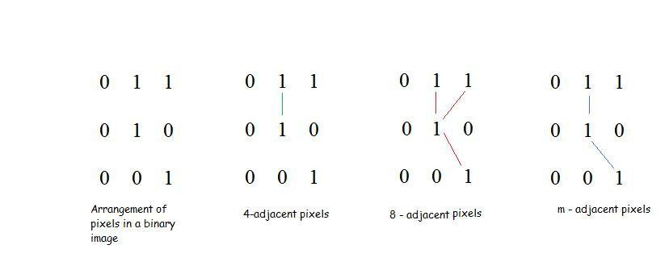
Adjacency
V: set of gray level values (L), (V is a subset of L.)
3 types of adjacency
4- adjacency: 2 pixels p and q with values from V are 4- adjacent if q is in the set N₄(p)
8- adjacency: 2 pixels p and q with values from V are 8- adjacent if q is in the set N₈(p)
m- adjacency: 2 pixels p and q with values from V are m-adjacent if
q is in N₄(p), or
q is in N_{D}(p) and the set N₄(p) ∩ N₄(q) has no pixels whose values are from V

Slide 56
A digital path
A digital path from pixel p with coordinates (x,y) to pixel q with coordinates (s,t) is a sequence of distinct pixels with coordinates (x₀,y₀), (x₁,y₁), …, (x_{n},y_{n}), where (x₀,y₀)= (x,y) and (x_{n},y_{n})=(s,t), and pixels (x_{i},y_{i}) and (x_{i-1},y_{i-1}) are adjacent for 1 ≤ i ≤ n.
n is the length of the path
If (x₀,y₀) = (x_{n}, y_{n}), the path is closed.
We can specify 4-, 8- or m-paths depending on the type of adjacency specified.

Slide 57
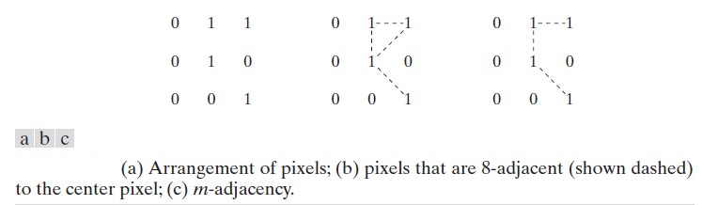
A Digital Path
Return to the previous example:
In figure (b) the paths between the top right and bottom right pixels are 8-paths. And the path between the same 2 pixels in figure (c) is m-path

Slide 58
Connectivity
S: a subset of pixels in an image.
Two pixels p and q are said to be connected in S if there exists a path between them consisting entirely of pixels in S.
For any pixel p in S, the set of pixels that are connected to it in S is called a connected component of S.

Slide 59
Regions and boundaries
Region
Let R be a subset of pixels in an image, we call R a
region of the image if R is a connected set.
000000
010010
011010
010110
000000
Boundary
The boundary (also called border or contour) of a region R is the set of pixels in the region that have one or more neighbors that are not in R
If R happens to be an entire image, then its boundary is defined as the set of pixels in the first and last rows and columns in the image.

Slide 60
Thank You

